Slide 1
Fundamentals of Predictive Analytics using Machine Learning techniques
(14 hours)
Notes:
Welcome to Fundamentals of Predictive Analytics using Machine Learning techniques

Slide 2
In this section, we will discuss:
Residuals in Regression
Polynomial features
Classification techniques
Types of distance metrics
KNN Classification
Gradient Decent
Notes:
In this section, we will discuss:
Residuals in Regression
Polynomial features
Classification techniques
Types of distance metrics
KNN Classification
Gradient Decent

Slide 3
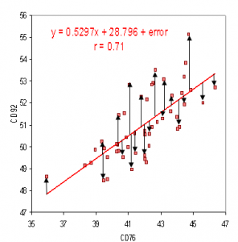
Residuals in Regression
What is it?
A residual is the vertical distance between a data point and the regression line.
Each data point has one residual.
Image Source: nws.noaa.gov
Notes:
When you perform simple linear regression (or any other type of regression analysis), you get a line of best fit. The data points usually don’t fall exactly on this regression equation line; they are scattered around. A residual is the vertical distance between a data point and the regression line.
Reference:
https://www.statisticshowto.com/residual/
https://machinelearningmastery.com/polynomial-features-transforms-for-machine-learning/#:~:text=Polynomial%20features%20are%20those%20features,X%2C%20e.g.%20X%5E2.
https://monkeylearn.com/blog/classification-algorithms/
https://machinelearningmastery.com/distance-measures-for-machine-learning/#:~:text=Perhaps%20four%20of%20the%20most,Manhattan%20Distance
https://www.javatpoint.com/k-nearest-neighbor-algorithm-for-machine-learning
https://towardsdatascience.com/gradient-descent-algorithm-a-deep-dive-cf04e8115f21
https://www.javatpoint.com/gradient-descent-in-machine-learning

Slide 4
Residuals in Regression
Types of residual
Positive if they are above the regression line,
Negative if they are below the regression line,
Zero if the regression line actually passes through the point
Image Source: nws.noaa.gov
Notes:
Each data point has one residual. They are:
Positive if they are above the regression line,
Negative if they are below the regression line,
Zero if the regression line actually passes through the point,
Reference:
https://www.statisticshowto.com/residual/
https://machinelearningmastery.com/polynomial-features-transforms-for-machine-learning/#:~:text=Polynomial%20features%20are%20those%20features,X%2C%20e.g.%20X%5E2.
https://monkeylearn.com/blog/classification-algorithms/
https://machinelearningmastery.com/distance-measures-for-machine-learning/#:~:text=Perhaps%20four%20of%20the%20most,Manhattan%20Distance
https://www.javatpoint.com/k-nearest-neighbor-algorithm-for-machine-learning
https://towardsdatascience.com/gradient-descent-algorithm-a-deep-dive-cf04e8115f21
https://www.javatpoint.com/gradient-descent-in-machine-learning

Slide 5
Residuals in Regression
More about residual
As residuals are the difference between any data point and the regression line, they are sometimes called “errors.”
In other words, the residual is the error that isn’t explained by the regression line.
Image Source: nws.noaa.gov
Notes:
As residuals are the difference between any data point and the regression line, they are sometimes called “errors.” Error in this context doesn’t mean that there’s something wrong with the analysis; it just means that there is some unexplained difference. In other words, the residual is the error that isn’t explained by the regression line.
Reference:
https://www.statisticshowto.com/residual/
https://machinelearningmastery.com/polynomial-features-transforms-for-machine-learning/#:~:text=Polynomial%20features%20are%20those%20features,X%2C%20e.g.%20X%5E2.
https://monkeylearn.com/blog/classification-algorithms/
https://machinelearningmastery.com/distance-measures-for-machine-learning/#:~:text=Perhaps%20four%20of%20the%20most,Manhattan%20Distance
https://www.javatpoint.com/k-nearest-neighbor-algorithm-for-machine-learning
https://towardsdatascience.com/gradient-descent-algorithm-a-deep-dive-cf04e8115f21
https://www.javatpoint.com/gradient-descent-in-machine-learning

Slide 6
Residuals in Regression
More about residual
The residual(e) can also be expressed with an equation.
Residual =
Observed value – predicted value
e = y – ŷ
Image Source: nws.noaa.gov
Notes:
The residual(e) can also be expressed with an equation. The e is the difference between the predicted value (ŷ) and the observed value. The scatter plot is a set of data points that are observed, while the regression line is the prediction.
Residual = Observed value – predicted value
e = y – ŷ
Reference:
https://www.statisticshowto.com/residual/
https://machinelearningmastery.com/polynomial-features-transforms-for-machine-learning/#:~:text=Polynomial%20features%20are%20those%20features,X%2C%20e.g.%20X%5E2.
https://monkeylearn.com/blog/classification-algorithms/
https://machinelearningmastery.com/distance-measures-for-machine-learning/#:~:text=Perhaps%20four%20of%20the%20most,Manhattan%20Distance
https://www.javatpoint.com/k-nearest-neighbor-algorithm-for-machine-learning
https://towardsdatascience.com/gradient-descent-algorithm-a-deep-dive-cf04e8115f21
https://www.javatpoint.com/gradient-descent-in-machine-learning

Slide 7
Polynomial features
Polynomial features are those features created by raising existing features to an exponent.
Polynomial features are a type of feature engineering, e.g. the creation of new input features based on the existing features.
The “degree” of the polynomial is used to control the number of features added, e.g. a degree of 3 will add two new variables for each input variable.
Notes:
Polynomial features are those features created by raising existing features to an exponent.
For example, if a dataset had one input feature X, then a polynomial feature would be the addition of a new feature (column) where values were calculated by squaring the values in X, e.g. X². This process can be repeated for each input variable in the dataset, creating a transformed version of each.
As such, polynomial features are a type of feature engineering, e.g. the creation of new input features based on the existing features.
The “degree” of the polynomial is used to control the number of features added, e.g. a degree of 3 will add two new variables for each input variable. Typically a small degree is used such as 2 or 3.
Reference:
https://www.statisticshowto.com/residual/
https://machinelearningmastery.com/polynomial-features-transforms-for-machine-learning/#:~:text=Polynomial%20features%20are%20those%20features,X%2C%20e.g.%20X%5E2.
https://monkeylearn.com/blog/classification-algorithms/
https://machinelearningmastery.com/distance-measures-for-machine-learning/#:~:text=Perhaps%20four%20of%20the%20most,Manhattan%20Distance
https://www.javatpoint.com/k-nearest-neighbor-algorithm-for-machine-learning
https://towardsdatascience.com/gradient-descent-algorithm-a-deep-dive-cf04e8115f21
https://www.javatpoint.com/gradient-descent-in-machine-learning

Slide 8
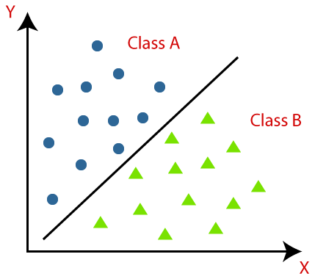
Classification techniques
What Is Classification?
Classification is the process of recognizing, understanding, and grouping ideas and objects into preset categories or “sub-populations.”
Classification algorithms in machine learning use input training data to predict the likelihood that subsequent data will fall into one of the predetermined categories.
Image Source: https://www.javatpoint.com/classification-algorithm-in-machine-learning
Notes:
What Is Classification?
Classification is the process of recognizing, understanding, and grouping ideas and objects into preset categories or “sub-populations.” Using pre-categorized training datasets, machine learning programs use a variety of algorithms to classify future datasets into categories.
Classification algorithms in machine learning use input training data to predict the likelihood that subsequent data will fall into one of the predetermined categories. One of the most common uses of classification is filtering emails into “spam” or “non-spam.”
In short, classification is a form of “pattern recognition,” with classification algorithms applied to the training data to find the same pattern (similar words or sentiments, number sequences, etc.) in future sets of data.
Reference:
https://www.statisticshowto.com/residual/
https://machinelearningmastery.com/polynomial-features-transforms-for-machine-learning/#:~:text=Polynomial%20features%20are%20those%20features,X%2C%20e.g.%20X%5E2.
https://monkeylearn.com/blog/classification-algorithms/
https://machinelearningmastery.com/distance-measures-for-machine-learning/#:~:text=Perhaps%20four%20of%20the%20most,Manhattan%20Distance
https://www.javatpoint.com/k-nearest-neighbor-algorithm-for-machine-learning
https://towardsdatascience.com/gradient-descent-algorithm-a-deep-dive-cf04e8115f21
https://www.javatpoint.com/gradient-descent-in-machine-learning

Slide 9
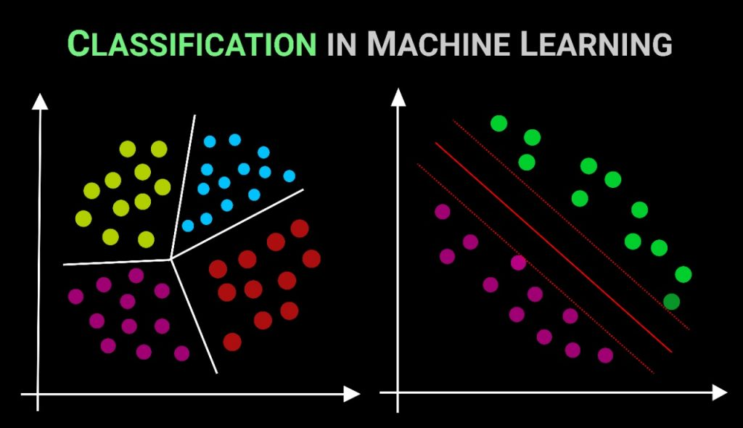
Classification techniques
Popular Classification Algorithms
Logistic Regression
Naive Bayes
K-Nearest Neighbors
Decision Tree
Support Vector Machines
Image Source: https://datamahadev.com/classification-algorithms-explained-in-30-minutes/
Notes:
Popular Classification Algorithms:
Logistic Regression
Naive Bayes
K-Nearest Neighbors
Decision Tree
Support Vector Machines
Reference:
https://www.statisticshowto.com/residual/
https://machinelearningmastery.com/polynomial-features-transforms-for-machine-learning/#:~:text=Polynomial%20features%20are%20those%20features,X%2C%20e.g.%20X%5E2.
https://monkeylearn.com/blog/classification-algorithms/
https://machinelearningmastery.com/distance-measures-for-machine-learning/#:~:text=Perhaps%20four%20of%20the%20most,Manhattan%20Distance
https://www.javatpoint.com/k-nearest-neighbor-algorithm-for-machine-learning
https://towardsdatascience.com/gradient-descent-algorithm-a-deep-dive-cf04e8115f21
https://www.javatpoint.com/gradient-descent-in-machine-learning

Slide 10
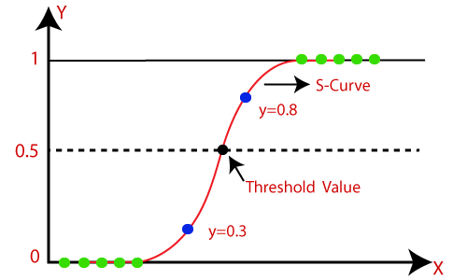
Classification techniques
Logistic Regression
Logistic Regression is a calculation used to predict a binary outcome: either something happens, or does not.
This can be exhibited as Yes/No, Pass/Fail, Alive/Dead, etc.
Image Source: https://www.javatpoint.com/logistic-regression-in-machine-learning
Notes:
Logistic regression is a calculation used to predict a binary outcome: either something happens, or does not. This can be exhibited as Yes/No, Pass/Fail, Alive/Dead, etc.
Independent variables are analyzed to determine the binary outcome with the results falling into one of two categories. The independent variables can be categorical or numeric, but the dependent variable is always categorical.
Reference:
https://www.statisticshowto.com/residual/
https://machinelearningmastery.com/polynomial-features-transforms-for-machine-learning/#:~:text=Polynomial%20features%20are%20those%20features,X%2C%20e.g.%20X%5E2.
https://monkeylearn.com/blog/classification-algorithms/
https://machinelearningmastery.com/distance-measures-for-machine-learning/#:~:text=Perhaps%20four%20of%20the%20most,Manhattan%20Distance
https://www.javatpoint.com/k-nearest-neighbor-algorithm-for-machine-learning
https://towardsdatascience.com/gradient-descent-algorithm-a-deep-dive-cf04e8115f21
https://www.javatpoint.com/gradient-descent-in-machine-learning

Slide 11
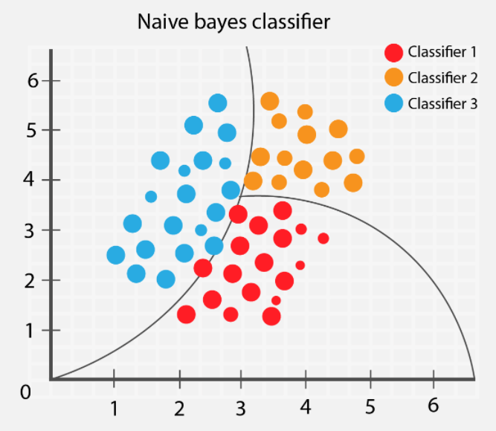
Classification techniques
Naive Bayes
Naive Bayes calculates the possibility of whether a data point belongs within a certain category or does not.
In text analysis, it can be used to categorize words or phrases as belonging to a preset “tag” (classification) or not.
Image Source: https://kdagiit.medium.com/naive-bayes-algorithm-4b8b990c7319
Notes:
Naive Bayes calculates the possibility of whether a data point belongs within a certain category or does not. In text analysis, it can be used to categorize words or phrases as belonging to a preset “tag” (classification) or not.
Reference:
https://www.statisticshowto.com/residual/
https://machinelearningmastery.com/polynomial-features-transforms-for-machine-learning/#:~:text=Polynomial%20features%20are%20those%20features,X%2C%20e.g.%20X%5E2.
https://monkeylearn.com/blog/classification-algorithms/
https://machinelearningmastery.com/distance-measures-for-machine-learning/#:~:text=Perhaps%20four%20of%20the%20most,Manhattan%20Distance
https://www.javatpoint.com/k-nearest-neighbor-algorithm-for-machine-learning
https://towardsdatascience.com/gradient-descent-algorithm-a-deep-dive-cf04e8115f21
https://www.javatpoint.com/gradient-descent-in-machine-learning

Slide 12
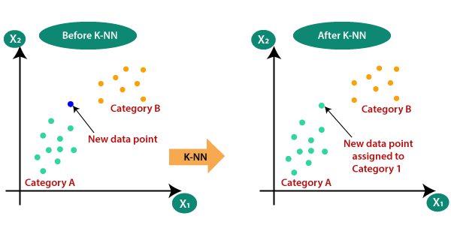
Classification techniques
K-nearest Neighbors
K-nearest neighbors (k-NN) is a pattern recognition algorithm that uses training datasets to find the k closest relatives.
When k-NN is used in classification, you calculate to place data within the category of its nearest neighbour.
Image Source: https://www.javatpoint.com/k-nearest-neighbor-algorithm-for-machine-learning
Notes:
K-nearest neighbors (k-NN) is a pattern recognition algorithm that uses training datasets to find the k closest relatives. When k-NN is used in classification, you calculate to place data within the category of its nearest neighbor. If k = 1, then it would be placed in the class nearest 1. K is classified by a plurality poll of its neighbors.
Reference:
https://www.statisticshowto.com/residual/
https://machinelearningmastery.com/polynomial-features-transforms-for-machine-learning/#:~:text=Polynomial%20features%20are%20those%20features,X%2C%20e.g.%20X%5E2.
https://monkeylearn.com/blog/classification-algorithms/
https://machinelearningmastery.com/distance-measures-for-machine-learning/#:~:text=Perhaps%20four%20of%20the%20most,Manhattan%20Distance
https://www.javatpoint.com/k-nearest-neighbor-algorithm-for-machine-learning
https://towardsdatascience.com/gradient-descent-algorithm-a-deep-dive-cf04e8115f21
https://www.javatpoint.com/gradient-descent-in-machine-learning

Slide 13

Classification techniques
Decision Tree
A decision tree is a supervised learning algorithm that is able to order classes on a precise level.
It works like a flow chart, separating data points into two similar categories at a time from the “tree trunk” to “branches,” to “leaves,” where the categories become more finitely similar.
This creates categories within categories, allowing for organic classification with limited human supervision.
Image Source: https://www.javatpoint.com/machine-learning-decision-tree-classification-algorithm
Notes:
A decision tree is a supervised learning algorithm that is perfect for classification problems, as it’s able to order classes on a precise level. It works like a flow chart, separating data points into two similar categories at a time from the “tree trunk” to “branches,” to “leaves,” where the categories become more finitely similar. This creates categories within categories, allowing for organic classification with limited human supervision.
Reference:
https://www.statisticshowto.com/residual/
https://machinelearningmastery.com/polynomial-features-transforms-for-machine-learning/#:~:text=Polynomial%20features%20are%20those%20features,X%2C%20e.g.%20X%5E2.
https://monkeylearn.com/blog/classification-algorithms/
https://machinelearningmastery.com/distance-measures-for-machine-learning/#:~:text=Perhaps%20four%20of%20the%20most,Manhattan%20Distance
https://www.javatpoint.com/k-nearest-neighbor-algorithm-for-machine-learning
https://towardsdatascience.com/gradient-descent-algorithm-a-deep-dive-cf04e8115f21
https://www.javatpoint.com/gradient-descent-in-machine-learning

Slide 14
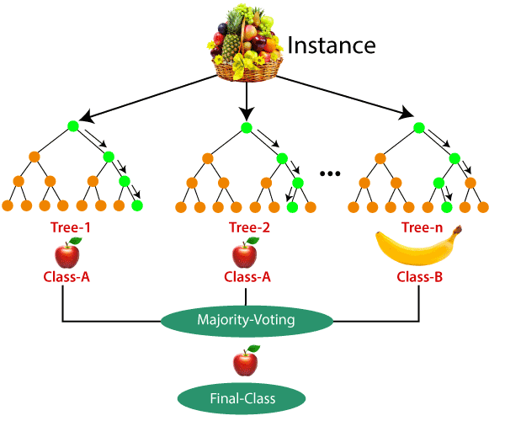
Classification techniques
Random Forest
The random forest algorithm is an expansion of decision tree
You first construct a multitude of decision trees with training data, then fit your new data within one of the trees as a “random forest.”
Image Source: https://www.javatpoint.com/machine-learning-random-forest-algorithm
Notes:
The random forest algorithm is an expansion of decision tree, in that you first construct a multitude of decision trees with training data, then fit your new data within one of the trees as a “random forest.”
It, essentially, averages your data to connect it to the nearest tree on the data scale. Random forest models are helpful as they remedy for the decision tree’s problem of “forcing” data points within a category unnecessarily.
Reference:
https://www.statisticshowto.com/residual/
https://machinelearningmastery.com/polynomial-features-transforms-for-machine-learning/#:~:text=Polynomial%20features%20are%20those%20features,X%2C%20e.g.%20X%5E2.
https://monkeylearn.com/blog/classification-algorithms/
https://machinelearningmastery.com/distance-measures-for-machine-learning/#:~:text=Perhaps%20four%20of%20the%20most,Manhattan%20Distance
https://www.javatpoint.com/k-nearest-neighbor-algorithm-for-machine-learning
https://towardsdatascience.com/gradient-descent-algorithm-a-deep-dive-cf04e8115f21
https://www.javatpoint.com/gradient-descent-in-machine-learning

Slide 15

Classification techniques
Support Vector Machines
A support vector machine (SVM) uses algorithms to train and classify data within degrees of polarity
The SVM then assigns a hyperplane that best separates the tags.
In two dimensions this is simply a line.
Image Source: https://www.javatpoint.com/machine-learning-support-vector-machine-algorithm
Notes:
A support vector machine (SVM) uses algorithms to train and classify data within degrees of polarity, taking it to a degree beyond X/Y prediction. The SVM then assigns a hyperplane that best separates the tags. In two dimensions this is simply a line. Anything on one side of the line is red and anything on the other side is blue. In sentiment analysis, for example, this would be positive and negative. In order to maximize machine learning, the best hyperplane is the one with the largest distance between each tag
Reference:
https://www.statisticshowto.com/residual/
https://machinelearningmastery.com/polynomial-features-transforms-for-machine-learning/#:~:text=Polynomial%20features%20are%20those%20features,X%2C%20e.g.%20X%5E2.
https://monkeylearn.com/blog/classification-algorithms/
https://machinelearningmastery.com/distance-measures-for-machine-learning/#:~:text=Perhaps%20four%20of%20the%20most,Manhattan%20Distance
https://www.javatpoint.com/k-nearest-neighbor-algorithm-for-machine-learning
https://towardsdatascience.com/gradient-descent-algorithm-a-deep-dive-cf04e8115f21
https://www.javatpoint.com/gradient-descent-in-machine-learning

Slide 16
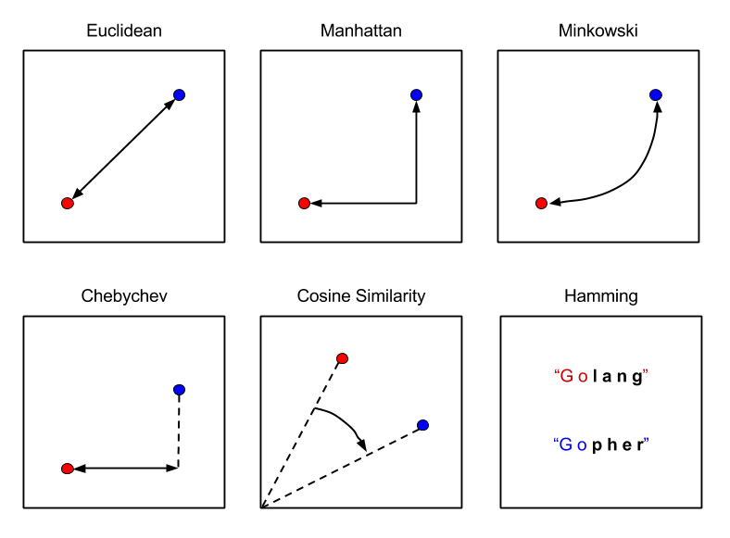
Distance metrics
What is it?
A distance measure is an objective score that summarizes the relative difference between two objects in a problem domain.
Different distance measures must be chosen and used depending on the types of the data.
Image Source: https://tuhinmukherjee74.medium.com/different-types-of-distances-used-in-machine-learning-explained-550e2979752c
Notes:
Distance measures play an important role in machine learning.
They provide the foundation for many popular and effective machine learning algorithms like k-nearest neighbors for supervised learning and k-means clustering for unsupervised learning. Different distance measures must be chosen and used depending on the types of the data. As such, it is important to know how to implement and calculate a range of different popular distance measures and the intuitions for the resulting scores.
Reference:
https://www.statisticshowto.com/residual/
https://machinelearningmastery.com/polynomial-features-transforms-for-machine-learning/#:~:text=Polynomial%20features%20are%20those%20features,X%2C%20e.g.%20X%5E2.
https://monkeylearn.com/blog/classification-algorithms/
https://machinelearningmastery.com/distance-measures-for-machine-learning/#:~:text=Perhaps%20four%20of%20the%20most,Manhattan%20Distance
https://www.javatpoint.com/k-nearest-neighbor-algorithm-for-machine-learning
https://towardsdatascience.com/gradient-descent-algorithm-a-deep-dive-cf04e8115f21
https://www.javatpoint.com/gradient-descent-in-machine-learning

Slide 17
Distance metrics
Types
Following are the 4 most commonly used distance measures in machine learning:
Hamming Distance
Euclidean Distance
Manhattan Distance
Minkowski Distance
Image Source: https://tuhinmukherjee74.medium.com/different-types-of-distances-used-in-machine-learning-explained-550e2979752c
Notes:
Following are the 4 most commonly used distance measures in machine learning:
Hamming Distance
Euclidean Distance
Manhattan Distance
Minkowski Distance
Reference:
https://www.statisticshowto.com/residual/
https://machinelearningmastery.com/polynomial-features-transforms-for-machine-learning/#:~:text=Polynomial%20features%20are%20those%20features,X%2C%20e.g.%20X%5E2.
https://monkeylearn.com/blog/classification-algorithms/
https://machinelearningmastery.com/distance-measures-for-machine-learning/#:~:text=Perhaps%20four%20of%20the%20most,Manhattan%20Distance
https://www.javatpoint.com/k-nearest-neighbor-algorithm-for-machine-learning
https://towardsdatascience.com/gradient-descent-algorithm-a-deep-dive-cf04e8115f21
https://www.javatpoint.com/gradient-descent-in-machine-learning

Slide 18
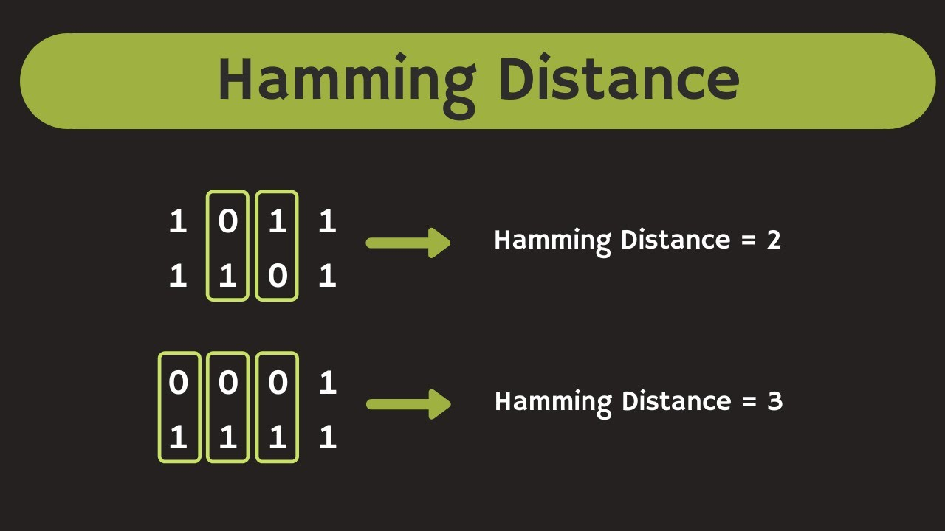
Distance metrics
Hamming Distance
Hamming distance calculates the distance between two binary vectors, also referred to as binary strings or bitstrings.
Image Source: https://www.youtube.com/watch?v=7SVSXiWc0-o
Notes:
Hamming distance calculates the distance between two binary vectors, also referred to as binary strings or bitstrings for short.
You are most likely going to encounter bitstrings when you one-hot encode categorical columns of data.
Reference:
https://www.statisticshowto.com/residual/
https://machinelearningmastery.com/polynomial-features-transforms-for-machine-learning/#:~:text=Polynomial%20features%20are%20those%20features,X%2C%20e.g.%20X%5E2.
https://monkeylearn.com/blog/classification-algorithms/
https://machinelearningmastery.com/distance-measures-for-machine-learning/#:~:text=Perhaps%20four%20of%20the%20most,Manhattan%20Distance
https://www.javatpoint.com/k-nearest-neighbor-algorithm-for-machine-learning
https://towardsdatascience.com/gradient-descent-algorithm-a-deep-dive-cf04e8115f21
https://www.javatpoint.com/gradient-descent-in-machine-learning

Slide 19
Distance metrics
Hamming Distance
Example :
Suppose there are two strings 1101 1001 and 1001 1101.
11011001 ⊕ 10011101 = 01000100. Since, this contains two 1s, the Hamming distance, d(11011001, 10011101) = 2.
Image Source: https://www.youtube.com/watch?v=7SVSXiWc0-o
Notes:
Reference:
https://www.statisticshowto.com/residual/
https://machinelearningmastery.com/polynomial-features-transforms-for-machine-learning/#:~:text=Polynomial%20features%20are%20those%20features,X%2C%20e.g.%20X%5E2.
https://monkeylearn.com/blog/classification-algorithms/
https://machinelearningmastery.com/distance-measures-for-machine-learning/#:~:text=Perhaps%20four%20of%20the%20most,Manhattan%20Distance
https://www.javatpoint.com/k-nearest-neighbor-algorithm-for-machine-learning
https://towardsdatascience.com/gradient-descent-algorithm-a-deep-dive-cf04e8115f21
https://www.javatpoint.com/gradient-descent-in-machine-learning

Slide 20
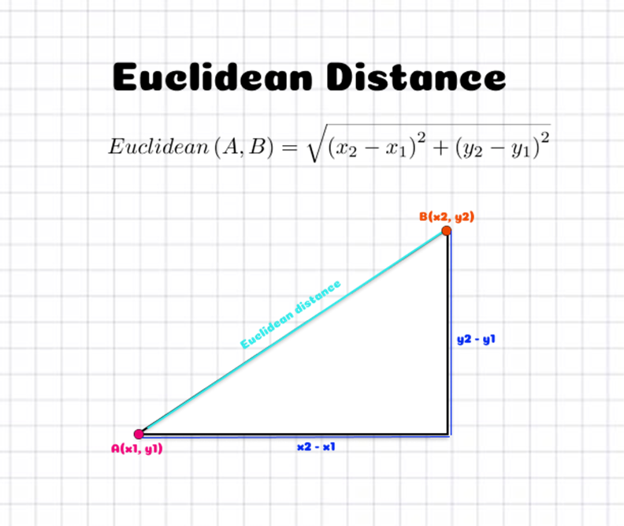
Distance metrics
Euclidean Distance
Euclidean distance calculates the distance between two real-valued vectors.
Euclidean distance is calculated as the square root of the sum of the squared differences between the two vectors.
EuclideanDistance = sqrt(sum for i to N (v1[i] – v2[i])^2)
Image Source: https://aigents.co/data-science-blog/publication/distance-metrics-for-machine-learning
Notes:
Euclidean distance calculates the distance between two real-valued vectors.
You are most likely to use Euclidean distance when calculating the distance between two rows of data that have numerical values, such a floating point or integer values.
If columns have values with differing scales, it is common to normalize or standardize the numerical values across all columns prior to calculating the Euclidean distance. Otherwise, columns that have large values will dominate the distance measure.
Euclidean distance is calculated as the square root of the sum of the squared differences between the two vectors.
Reference:
https://www.statisticshowto.com/residual/
https://machinelearningmastery.com/polynomial-features-transforms-for-machine-learning/#:~:text=Polynomial%20features%20are%20those%20features,X%2C%20e.g.%20X%5E2.
https://monkeylearn.com/blog/classification-algorithms/
https://machinelearningmastery.com/distance-measures-for-machine-learning/#:~:text=Perhaps%20four%20of%20the%20most,Manhattan%20Distance
https://www.javatpoint.com/k-nearest-neighbor-algorithm-for-machine-learning
https://towardsdatascience.com/gradient-descent-algorithm-a-deep-dive-cf04e8115f21
https://www.javatpoint.com/gradient-descent-in-machine-learning

Slide 21
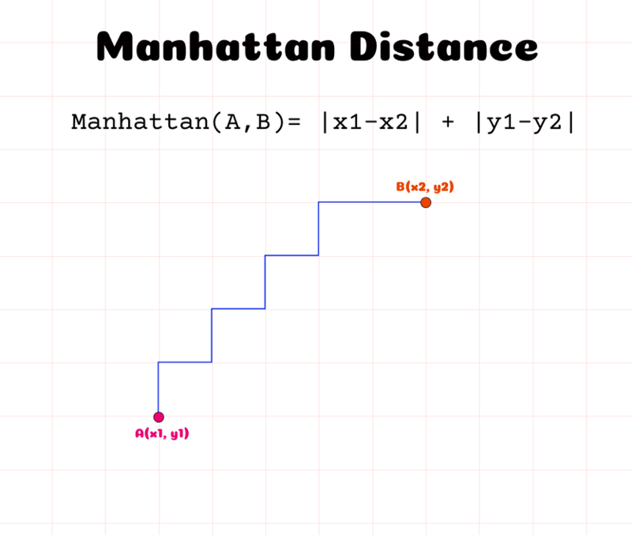
Distance metrics
Manhattan Distance
The Manhattan distance, also called the Taxicab distance or the City Block distance, calculates the distance between two real-valued vectors.
The taxicab name for the measure refers to the intuition for what the measure calculates: the shortest path that a taxicab would take between city blocks (coordinates on the grid).
Image Source: https://aigents.co/data-science-blog/publication/distance-metrics-for-machine-learning
Notes:
The Manhattan distance, also called the Taxicab distance or the City Block distance, calculates the distance between two real-valued vectors.
It is perhaps more useful to vectors that describe objects on a uniform grid, like a chessboard or city blocks. The taxicab name for the measure refers to the intuition for what the measure calculates: the shortest path that a taxicab would take between city blocks (coordinates on the grid).
Reference:
https://www.statisticshowto.com/residual/
https://machinelearningmastery.com/polynomial-features-transforms-for-machine-learning/#:~:text=Polynomial%20features%20are%20those%20features,X%2C%20e.g.%20X%5E2.
https://monkeylearn.com/blog/classification-algorithms/
https://machinelearningmastery.com/distance-measures-for-machine-learning/#:~:text=Perhaps%20four%20of%20the%20most,Manhattan%20Distance
https://www.javatpoint.com/k-nearest-neighbor-algorithm-for-machine-learning
https://towardsdatascience.com/gradient-descent-algorithm-a-deep-dive-cf04e8115f21
https://www.javatpoint.com/gradient-descent-in-machine-learning

Slide 22
Distance metrics
Manhattan Distance
Manhattan distance is calculated as the sum of the absolute differences between the two vectors.
The Manhattan Distance between two points (X1, Y1) and (X2, Y2) is given by |X1 – X2| + |Y1 – Y2|.
Image Source: https://aigents.co/data-science-blog/publication/distance-metrics-for-machine-learning
Notes:
Reference:
https://www.statisticshowto.com/residual/
https://machinelearningmastery.com/polynomial-features-transforms-for-machine-learning/#:~:text=Polynomial%20features%20are%20those%20features,X%2C%20e.g.%20X%5E2.
https://monkeylearn.com/blog/classification-algorithms/
https://machinelearningmastery.com/distance-measures-for-machine-learning/#:~:text=Perhaps%20four%20of%20the%20most,Manhattan%20Distance
https://www.javatpoint.com/k-nearest-neighbor-algorithm-for-machine-learning
https://towardsdatascience.com/gradient-descent-algorithm-a-deep-dive-cf04e8115f21
https://www.javatpoint.com/gradient-descent-in-machine-learning

Slide 23
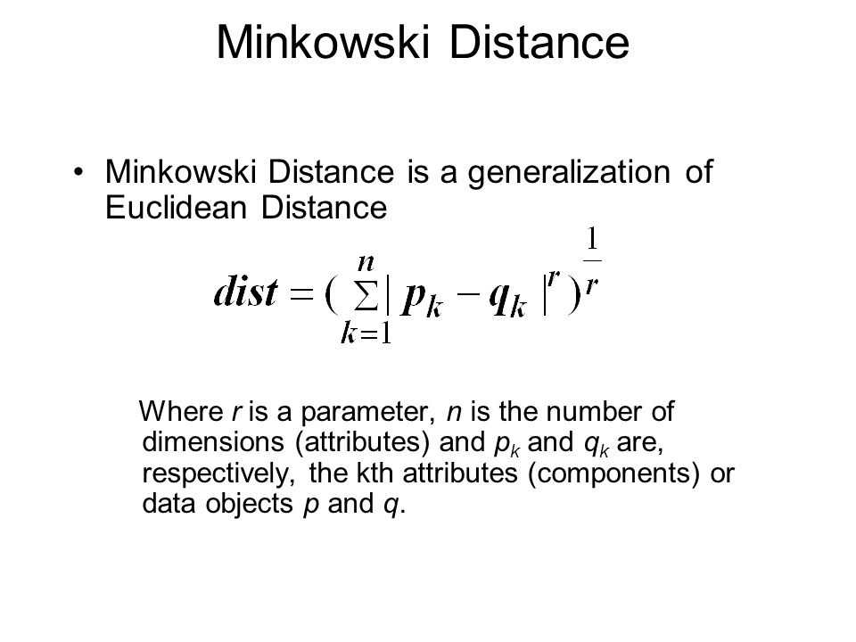
Distance metrics
Minkowski Distance
Minkowski distance calculates the distance between two real-valued vectors.
It is a generalization of the Euclidean and Manhattan distance measures and adds a parameter, called the “order” or “p“, that allows different distance measures to be calculated.
Image Source: https://slideplayer.com/slide/5139522/
Notes:
Minkowski distance calculates the distance between two real-valued vectors.
It is a generalization of the Euclidean and Manhattan distance measures and adds a parameter, called the “order” or “p“, that allows different distance measures to be calculated.
Reference:
https://www.statisticshowto.com/residual/
https://machinelearningmastery.com/polynomial-features-transforms-for-machine-learning/#:~:text=Polynomial%20features%20are%20those%20features,X%2C%20e.g.%20X%5E2.
https://monkeylearn.com/blog/classification-algorithms/
https://machinelearningmastery.com/distance-measures-for-machine-learning/#:~:text=Perhaps%20four%20of%20the%20most,Manhattan%20Distance
https://www.javatpoint.com/k-nearest-neighbor-algorithm-for-machine-learning
https://towardsdatascience.com/gradient-descent-algorithm-a-deep-dive-cf04e8115f21
https://www.javatpoint.com/gradient-descent-in-machine-learning

Slide 24
Distance metrics
Minkowski Distance
For example:
Given two vectors, vect1 as (4, 2, 6, 8) and vect2 as (5, 1, 7, 9). Their Minkowski distance for p = 2 is given by, ( |4 – 5|2 + |2 – 1|2 + |6 – 7|2 + |8 – 9|2 )1/2 which is equal to 2.
Image Source: https://slideplayer.com/slide/5139522/
Notes:
Reference:
https://www.statisticshowto.com/residual/
https://machinelearningmastery.com/polynomial-features-transforms-for-machine-learning/#:~:text=Polynomial%20features%20are%20those%20features,X%2C%20e.g.%20X%5E2.
https://monkeylearn.com/blog/classification-algorithms/
https://machinelearningmastery.com/distance-measures-for-machine-learning/#:~:text=Perhaps%20four%20of%20the%20most,Manhattan%20Distance
https://www.javatpoint.com/k-nearest-neighbor-algorithm-for-machine-learning
https://towardsdatascience.com/gradient-descent-algorithm-a-deep-dive-cf04e8115f21
https://www.javatpoint.com/gradient-descent-in-machine-learning

Slide 25
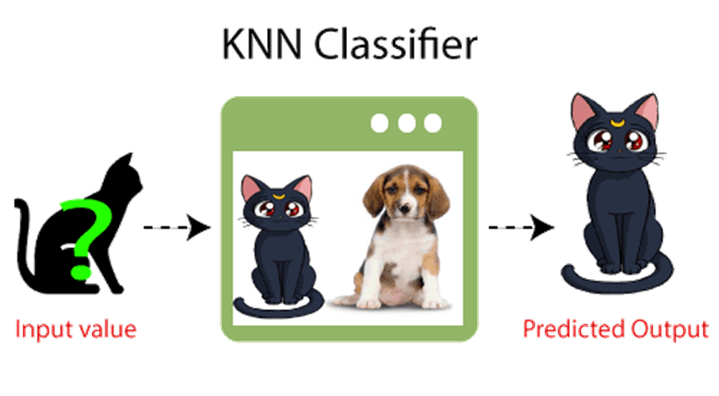
KNN Classification
Concept
K-Nearest Neighbour is one of the simplest Machine Learning algorithms based on Supervised Learning technique.
K-NN algorithm assumes the similarity between the new case/data and available cases and put the new case into the category that is most similar to the available categories.
Image source: https://www.javatpoint.com/k-nearest-neighbor-algorithm-for-machine-learning
Notes:
K-Nearest Neighbour is one of the simplest Machine Learning algorithms based on Supervised Learning technique.
K-NN algorithm assumes the similarity between the new case/data and available cases and put the new case into the category that is most similar to the available categories.
K-NN algorithm stores all the available data and classifies a new data point based on the similarity. This means when new data appears then it can be easily classified into a well suite category by using K- NN algorithm.
Reference:
https://www.statisticshowto.com/residual/
https://machinelearningmastery.com/polynomial-features-transforms-for-machine-learning/#:~:text=Polynomial%20features%20are%20those%20features,X%2C%20e.g.%20X%5E2.
https://monkeylearn.com/blog/classification-algorithms/
https://machinelearningmastery.com/distance-measures-for-machine-learning/#:~:text=Perhaps%20four%20of%20the%20most,Manhattan%20Distance
https://www.javatpoint.com/k-nearest-neighbor-algorithm-for-machine-learning
https://towardsdatascience.com/gradient-descent-algorithm-a-deep-dive-cf04e8115f21
https://www.javatpoint.com/gradient-descent-in-machine-learning

Slide 26
KNN Classification
Concept
K-NN algorithm can be used for Regression as well as for Classification but mostly it is used for the Classification problems.
It is also called a lazy learner algorithm because it does not learn from the training set immediately instead it stores the dataset and at the time of classification, it performs an action on the dataset.
Image source: https://www.javatpoint.com/k-nearest-neighbor-algorithm-for-machine-learning
Notes:
K-NN algorithm can be used for Regression as well as for Classification but mostly it is used for the Classification problems.
K-NN is a non-parametric algorithm, which means it does not make any assumption on underlying data.
It is also called a lazy learner algorithm because it does not learn from the training set immediately instead it stores the dataset and at the time of classification, it performs an action on the dataset.
KNN algorithm at the training phase just stores the dataset and when it gets new data, then it classifies that data into a category that is much similar to the new data.
Reference:
https://www.statisticshowto.com/residual/
https://machinelearningmastery.com/polynomial-features-transforms-for-machine-learning/#:~:text=Polynomial%20features%20are%20those%20features,X%2C%20e.g.%20X%5E2.
https://monkeylearn.com/blog/classification-algorithms/
https://machinelearningmastery.com/distance-measures-for-machine-learning/#:~:text=Perhaps%20four%20of%20the%20most,Manhattan%20Distance
https://www.javatpoint.com/k-nearest-neighbor-algorithm-for-machine-learning
https://towardsdatascience.com/gradient-descent-algorithm-a-deep-dive-cf04e8115f21
https://www.javatpoint.com/gradient-descent-in-machine-learning

Slide 27
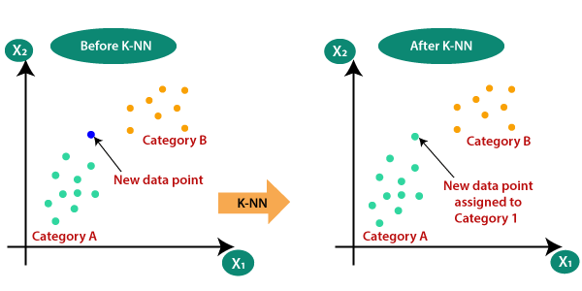
KNN Classification
Why do we need a K-NN Algorithm?
With the help of K-NN, we can easily identify the category or class of a particular dataset.
Suppose there are two categories, i.e., Category A and Category B, and we have a new data point x1, so this data point will lie in which of these categories. To solve this type of problem, we need a K-NN algorithm.
Image Source: https://www.javatpoint.com/k-nearest-neighbor-algorithm-for-machine-learning
Notes:
Suppose there are two categories, i.e., Category A and Category B, and we have a new data point x1, so this data point will lie in which of these categories. To solve this type of problem, we need a K-NN algorithm. With the help of K-NN, we can easily identify the category or class of a particular dataset.
Reference:
https://www.statisticshowto.com/residual/
https://machinelearningmastery.com/polynomial-features-transforms-for-machine-learning/#:~:text=Polynomial%20features%20are%20those%20features,X%2C%20e.g.%20X%5E2.
https://monkeylearn.com/blog/classification-algorithms/
https://machinelearningmastery.com/distance-measures-for-machine-learning/#:~:text=Perhaps%20four%20of%20the%20most,Manhattan%20Distance
https://www.javatpoint.com/k-nearest-neighbor-algorithm-for-machine-learning
https://towardsdatascience.com/gradient-descent-algorithm-a-deep-dive-cf04e8115f21
https://www.javatpoint.com/gradient-descent-in-machine-learning

Slide 28
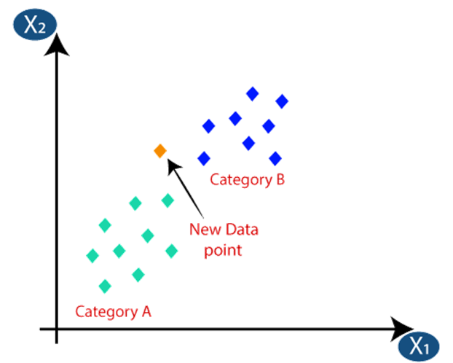
KNN Classification
How does K-NN work?
Step-1: Select the number K of the neighbors
Step-2: Calculate the Euclidean distance of K number of neighbors
Image Source: https://www.javatpoint.com/k-nearest-neighbor-algorithm-for-machine-learning
Notes:
The K-NN working can be explained on the basis of the below algorithm:
Step-1: Select the number K of the neighbors
Step-2: Calculate the Euclidean distance of K number of neighbors
Reference:
https://www.statisticshowto.com/residual/
https://machinelearningmastery.com/polynomial-features-transforms-for-machine-learning/#:~:text=Polynomial%20features%20are%20those%20features,X%2C%20e.g.%20X%5E2.
https://monkeylearn.com/blog/classification-algorithms/
https://machinelearningmastery.com/distance-measures-for-machine-learning/#:~:text=Perhaps%20four%20of%20the%20most,Manhattan%20Distance
https://www.javatpoint.com/k-nearest-neighbor-algorithm-for-machine-learning
https://towardsdatascience.com/gradient-descent-algorithm-a-deep-dive-cf04e8115f21
https://www.javatpoint.com/gradient-descent-in-machine-learning

Slide 29
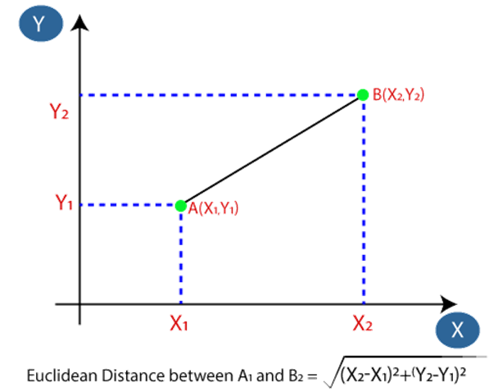
KNN Classification
How does K-NN work?
Step-3: Take the K nearest neighbors as per the calculated Euclidean distance.
Step-4: Among these k neighbors, count the number of the data points in each category.
Image Source: https://www.javatpoint.com/k-nearest-neighbor-algorithm-for-machine-learning
Notes:
Step-3: Take the K nearest neighbors as per the calculated Euclidean distance.
Step-4: Among these k neighbors, count the number of the data points in each category.
Reference:
https://www.statisticshowto.com/residual/
https://machinelearningmastery.com/polynomial-features-transforms-for-machine-learning/#:~:text=Polynomial%20features%20are%20those%20features,X%2C%20e.g.%20X%5E2.
https://monkeylearn.com/blog/classification-algorithms/
https://machinelearningmastery.com/distance-measures-for-machine-learning/#:~:text=Perhaps%20four%20of%20the%20most,Manhattan%20Distance
https://www.javatpoint.com/k-nearest-neighbor-algorithm-for-machine-learning
https://towardsdatascience.com/gradient-descent-algorithm-a-deep-dive-cf04e8115f21
https://www.javatpoint.com/gradient-descent-in-machine-learning

Slide 30
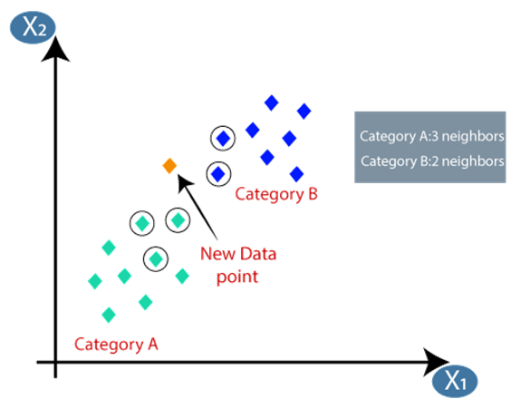
KNN Classification
How does K-NN work?
Step-5: Assign the new data points to that category for which the number of the neighbor is maximum.
Step-6: Our model is ready.
Image Source: https://www.javatpoint.com/k-nearest-neighbor-algorithm-for-machine-learning
Notes:
Step-5: Assign the new data points to that category for which the number of the neighbor is maximum.
Step-6: Our model is ready.
Reference:
https://www.statisticshowto.com/residual/
https://machinelearningmastery.com/polynomial-features-transforms-for-machine-learning/#:~:text=Polynomial%20features%20are%20those%20features,X%2C%20e.g.%20X%5E2.
https://monkeylearn.com/blog/classification-algorithms/
https://machinelearningmastery.com/distance-measures-for-machine-learning/#:~:text=Perhaps%20four%20of%20the%20most,Manhattan%20Distance
https://www.javatpoint.com/k-nearest-neighbor-algorithm-for-machine-learning
https://towardsdatascience.com/gradient-descent-algorithm-a-deep-dive-cf04e8115f21
https://www.javatpoint.com/gradient-descent-in-machine-learning

Slide 31
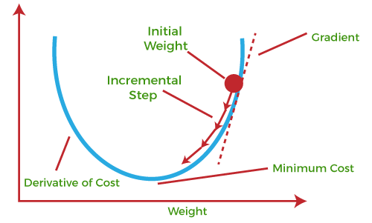
Gradient Descent
Concept
Gradient descent (GD) is an iterative first-order optimisation algorithm used to find a local minimum/maximum of a given function.
This method is commonly used in machine learning (ML) and deep learning(DL) to minimise a cost/loss function (e.g. in a linear regression).
Image Source: https://www.javatpoint.com/gradient-descent-in-machine-learning
Notes:
Gradient descent (GD) is an iterative first-order optimisation algorithm used to find a local minimum/maximum of a given function. This method is commonly used in machine learning (ML) and deep learning(DL) to minimise a cost/loss function (e.g. in a linear regression). Due to its importance and ease of implementation, this algorithm is usually taught at the beginning of almost all machine learning courses.
Reference:
https://www.statisticshowto.com/residual/
https://machinelearningmastery.com/polynomial-features-transforms-for-machine-learning/#:~:text=Polynomial%20features%20are%20those%20features,X%2C%20e.g.%20X%5E2.
https://monkeylearn.com/blog/classification-algorithms/
https://machinelearningmastery.com/distance-measures-for-machine-learning/#:~:text=Perhaps%20four%20of%20the%20most,Manhattan%20Distance
https://www.javatpoint.com/k-nearest-neighbor-algorithm-for-machine-learning
https://towardsdatascience.com/gradient-descent-algorithm-a-deep-dive-cf04e8115f21
https://www.javatpoint.com/gradient-descent-in-machine-learning

Slide 32
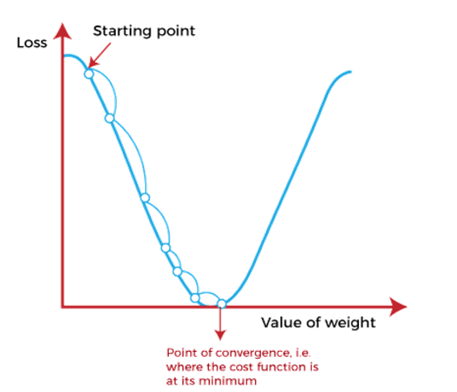
Gradient Descent
How does Gradient Descent work?
The equation for simple linear regression is given as:
Y=mX+c
Where 'm' represents the slope of the line, and 'c' represents the intercepts on the y-axis.
Image Source:: https://www.javatpoint.com/gradient-descent-in-machine-learning
Notes:
Before starting the working principle of gradient descent, we should know some basic concepts to find out the slope of a line from linear regression. The equation for simple linear regression is given as:
Y=mX+c
Where 'm' represents the slope of the line, and 'c' represents the intercepts on the y-axis.
Reference:
https://www.statisticshowto.com/residual/
https://machinelearningmastery.com/polynomial-features-transforms-for-machine-learning/#:~:text=Polynomial%20features%20are%20those%20features,X%2C%20e.g.%20X%5E2.
https://monkeylearn.com/blog/classification-algorithms/
https://machinelearningmastery.com/distance-measures-for-machine-learning/#:~:text=Perhaps%20four%20of%20the%20most,Manhattan%20Distance
https://www.javatpoint.com/k-nearest-neighbor-algorithm-for-machine-learning
https://towardsdatascience.com/gradient-descent-algorithm-a-deep-dive-cf04e8115f21
https://www.javatpoint.com/gradient-descent-in-machine-learning

Slide 33
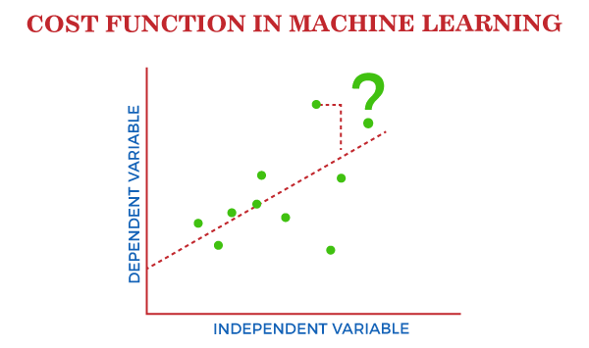
Gradient Descent
What is Cost-function?
The cost function is defined as the measurement of difference or error between actual values and expected values at the current position and present in the form of a single real number.
It helps to increase and improve machine learning efficiency by providing feedback to this model so that it can minimize error and find the local or global minimum.
Image Source:: https://www.javatpoint.com/cost-function-in-machine-learning
Notes:
What is Cost-function?
The cost function is defined as the measurement of difference or error between actual values and expected values at the current position and present in the form of a single real number.
It helps to increase and improve machine learning efficiency by providing feedback to this model so that it can minimize error and find the local or global minimum.
Reference:
https://www.statisticshowto.com/residual/
https://machinelearningmastery.com/polynomial-features-transforms-for-machine-learning/#:~:text=Polynomial%20features%20are%20those%20features,X%2C%20e.g.%20X%5E2.
https://monkeylearn.com/blog/classification-algorithms/
https://machinelearningmastery.com/distance-measures-for-machine-learning/#:~:text=Perhaps%20four%20of%20the%20most,Manhattan%20Distance
https://www.javatpoint.com/k-nearest-neighbor-algorithm-for-machine-learning
https://towardsdatascience.com/gradient-descent-algorithm-a-deep-dive-cf04e8115f21
https://www.javatpoint.com/gradient-descent-in-machine-learning

Slide 34
Gradient Descent
The Gradient Descent Algorithm
Gradient Descent method’s steps are:
Choose a starting point (initialisation)
Calculate gradient at this point
Make a scaled step in the opposite direction to the gradient (objective: minimise)
Repeat points 2 and 3 until one of the criteria is met:
Maximum number of iterations reached
Step size is smaller than the tolerance.
Image Source:: https://www.javatpoint.com/gradient-descent-in-machine-learning
Notes:
Gradient Descent Algorithm iteratively calculates the next point using gradient at the current position, then scales it (by a learning rate) and subtracts obtained value from the current position (makes a step). It subtracts the value because we want to minimise the function (to maximise it would be adding). This process can be written as:
There’s an important parameter η which scales the gradient and thus controls the step size. In machine learning, it is called learning rate and have a strong influence on performance.
The smaller learning rate the longer GD converges, or may reach maximum iteration before reaching the optimum point
If learning rate is too big the algorithm may not converge to the optimal point (jump around) or even to diverge completely.
In summary, Gradient Descent method’s steps are:
choose a starting point (initialisation)
calculate gradient at this point
make a scaled step in the opposite direction to the gradient (objective: minimise)
repeat points 2 and 3 until one of the criteria is met:
maximum number of iterations reached
step size is smaller than the tolerance.
Reference:
https://www.statisticshowto.com/residual/
https://machinelearningmastery.com/polynomial-features-transforms-for-machine-learning/#:~:text=Polynomial%20features%20are%20those%20features,X%2C%20e.g.%20X%5E2.
https://monkeylearn.com/blog/classification-algorithms/
https://machinelearningmastery.com/distance-measures-for-machine-learning/#:~:text=Perhaps%20four%20of%20the%20most,Manhattan%20Distance
https://www.javatpoint.com/k-nearest-neighbor-algorithm-for-machine-learning
https://towardsdatascience.com/gradient-descent-algorithm-a-deep-dive-cf04e8115f21
https://www.javatpoint.com/gradient-descent-in-machine-learning

